Slide 1
Document Object Model(DOM)
Gireesh Kumar T

Slide 2
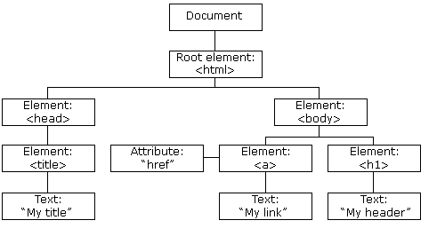
HTML DOM Tree of Objects

Slide 3
With the object model, JavaScript gets all the power it needs to create dynamic HTML:
can change all the HTML elements in the page
can change all the HTML attributes in the page
can change all the CSS styles in the page
can remove existing HTML elements and attributes
can add new HTML elements and attributes
can react to all existing HTML events in the page
can create new HTML events in the page

Slide 4
Learn
How to change the content of HTML elements
How to change the style (CSS) of HTML elements
How to react to HTML DOM events
How to add and delete HTML elements
DOM is a platform and language-neutral interface that allows programs and scripts to dynamically access and update the content, structure, and style of a document
DOM standard is separated into 3 different parts:
Core DOM - standard model for all document types
XML DOM - standard model for XML documents
HTML DOM - standard model for HTML documents

Slide 5
What is the HTML DOM?
The HTML DOM is a standard object model and programming interface for HTML.
It defines:
The HTML elements as objects
The properties of all HTML elements
The methods to access all HTML elements
The events for all HTML elements
In other words: The HTML DOM is a standard for how to get, change, add, or delete HTML elements.

Slide 6
JavaScript - HTML DOM Methods
HTML DOM methods are actions you can perform (on HTML Elements).
HTML DOM properties are values (of HTML Elements) that you can set or change.
In the DOM, all HTML elements are defined as objects

Slide 7
HTML elements
The basic elements of an HTML page are:
A text header, denoted using the <h1>, <h2>, <h3>, <h4>, <h5>, <h6> tags.
A paragraph, denoted using the <p> tag.
A horizontal ruler, denoted using the <hr> tag.
A link, denoted using the <a> (anchor) tag.
A list, denoted using the <ul> (unordered list), <ol> (ordered list) and <li> (list element) tags.
An image, denoted using the <img> tag
A divider, denoted using the <div> tag
A text span, denoted using the <span> tag

Slide 8
Example
changes the content (the innerHTML) of the <p> element with id="demo":
<html> <body> <p id="demo"></p> <script> document.getElementById("demo").innerHTML = "Hello World!"; </script> </body> </html>
getElementById is a method, while innerHTML is a property.

Slide 9
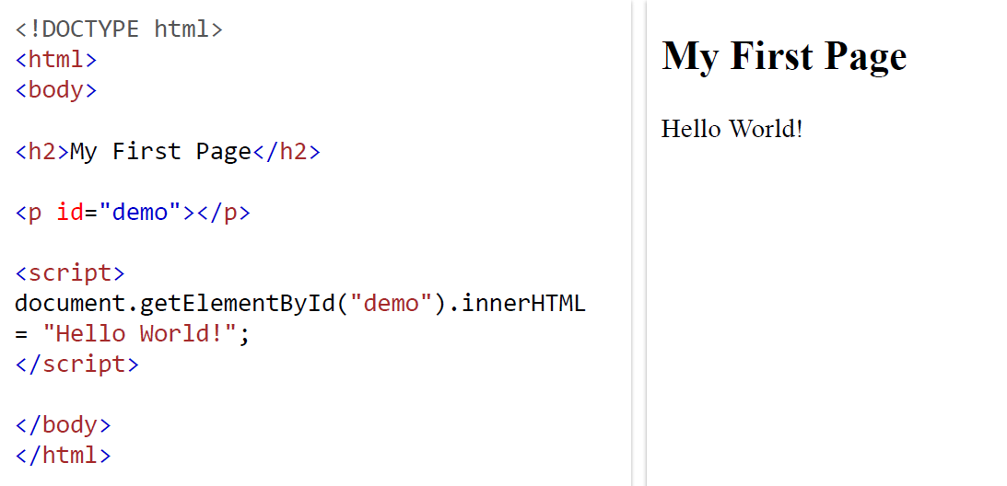

Slide 10
The getElementById Method
most common way to access an HTML element is to use the id of the element.
In the example above the getElementById method used id="demo" to find the element.
The innerHTML Property
easiest way to get the content of an element is by using the innerHTML property.
innerHTML property is useful for getting or replacing the content of HTML elements.
innerHTML property can be used to get or change any HTML element, including <html> and <body>

Slide 11
HTML DOM Document Object
The document object represents your web page.
If you want to access any element in an HTML page, you always start with accessing the document object.
Finding HTML Elements
some examples of how you can use the document object to access and manipulate HTML(next slide)

Slide 12
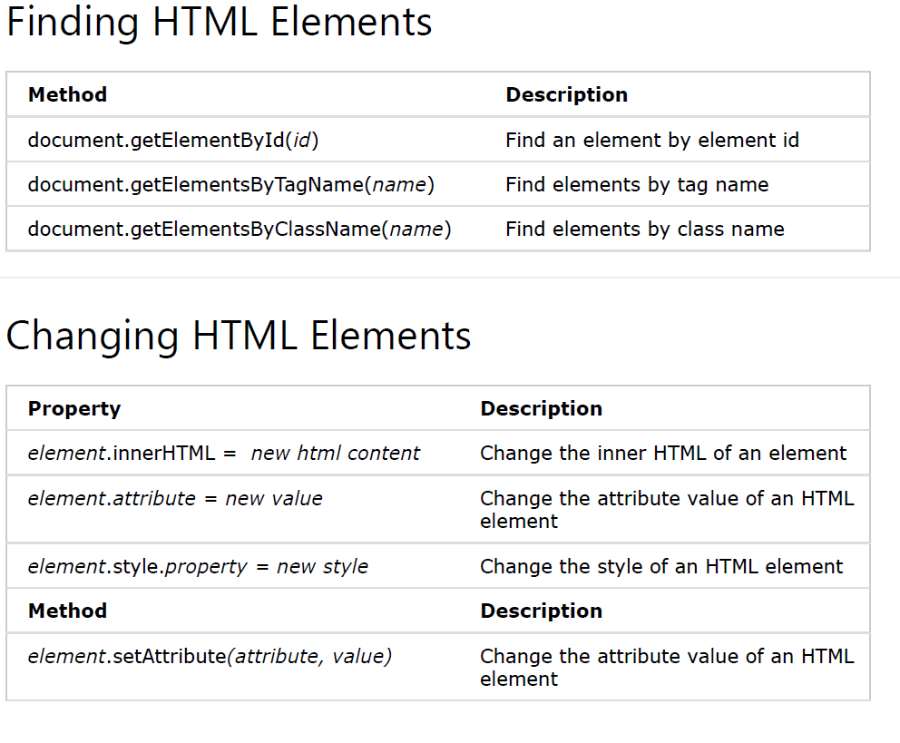

Slide 13
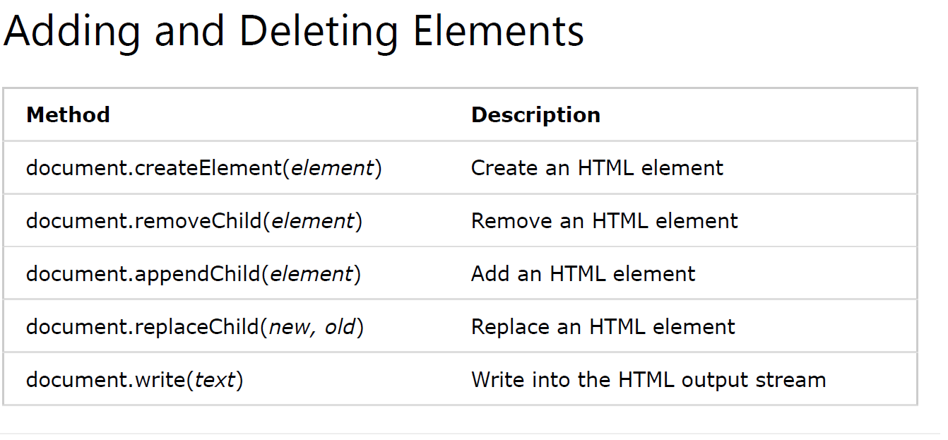

Slide 14
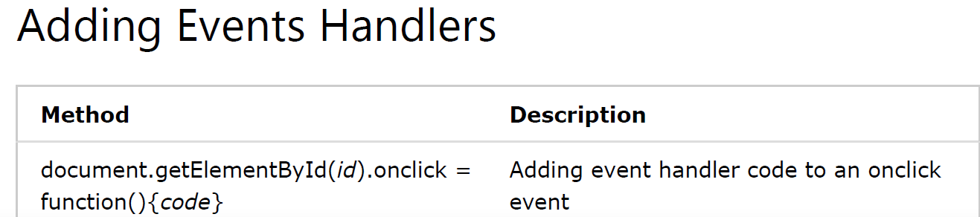

Slide 15
Exercises
https://www.guru99.com/how-to-use-dom-and-events-in-javascript.html
https://www.w3schools.com/js/js_dom_examples.asp
https://www.w3schools.com/js/js_examples.asp
https://www.w3schools.com/js/js_quiz.asp

